Slide 1
Future of Nuclear Power in the PJM Footprint
Kathleen L. Barrón
Senior Vice President,
Federal Regulatory Affairs and Wholesale Market Policy

Slide 2
Exelon Overview
Generation | Energy Sales & Services | Transmission & Delivery
Exelon Generation | Constellation | BGE, ComEd, PEPCO, Atlantic City Electric, Delmarva Power, PECO
With a generation capacity of 32,700 MW, Exelon Generation is the largest clean power generator and one of the largest competitive power generators in the nation. With strong positions in Illinois, the Mid-Atlantic, Texas, and California, Exelon is the largest owner and operator of nuclear plants in the U.S. | Competitive Load Served: 180 TWH (power) 650 BCF (natural gas) Competitive Energy Sales: 175,000 business & public sector customers Approximately 1.7 million residential customers | Exelon’s six utilities deliver electricity and natural gas to approximately 10 million customers covering 24,200 miles of service territory in Delaware, the District of Columbia, Illinois, Maryland, New Jersey and Pennsylvania
Exelon’s family of companies represent every stage of the energy value chain

Slide 3
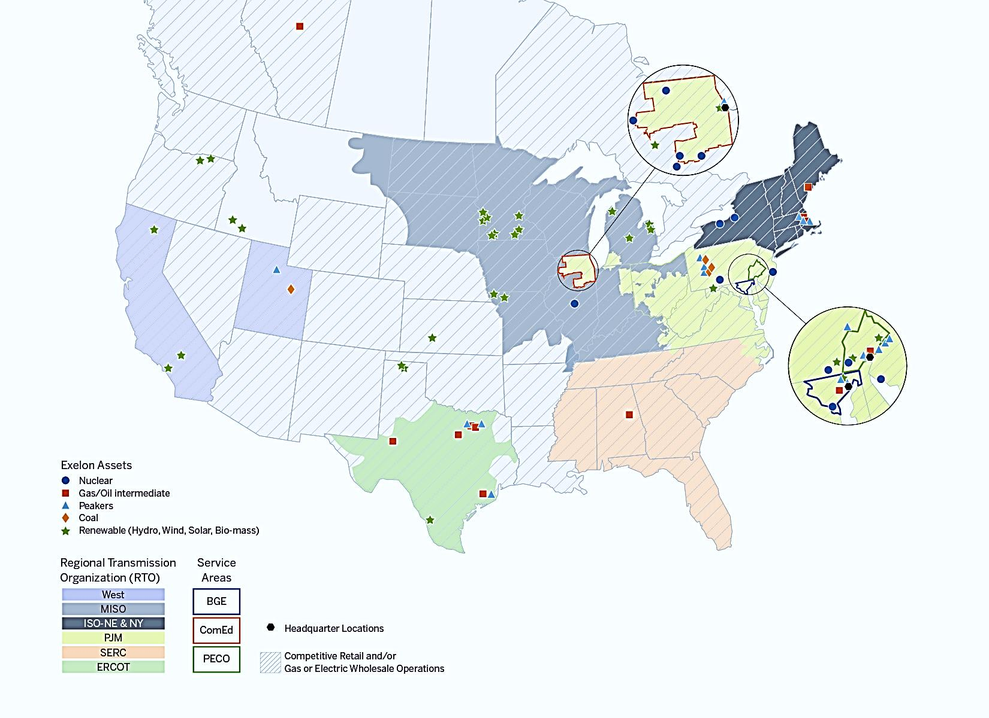
Exelon Generation Overview
Exelon primarily operates in areas that have restructured markets
These markets have been restructured to promote competition among energy market participants, while maintaining strict regulatory oversight
Power Generation
Operations in seven RTOs, with strong positions across PJM, ERCOT & New England
Constellation
Serves more than 2/3 of the Fortune 100 companies in the U.S.
Exelon Utilities
Large urban presence with operations in five states and the District of Columbia
Sources: Exelon, Compete Coalition

Slide 4
World-Class Nuclear Operator
First Quartile in Major Cost and Performance Categories
Nuclear Fuel & Direct O&M Cost ($/MWh)
Capacity Factor (%)
[Electric Utility Cost Group Survey]
EXC
[Nuclear Energy Institute and EIA]
14%
EXC
31%
14%
Nuclear Production Cost (‘09-’13)
Nuclear Capacity Factor (‘09-’13)
36%
Fleet Average Refueling Outage Duration (Days)
Institute of Nuclear Power Operations Index (Points)
EXC
EXC
14%
31%
Average INPO Index (‘09-’13)
14%
Average Refueling Duration (‘09-’13)
1,104
1,169
1,208
36%
Among major nuclear plant fleet operators, Exelon is consistently one of the lowest-cost and most efficient producers of electricity in the nation, even factoring in post Fukushima costs
Notes:
3
Source: 2013 Electric Utility Cost Group (EUCG) survey. Includes Fuel Cost plus Direct O&M divided by net generation.
Source: Platts Nuclear News, Nuclear Energy Institute and Energy Information Administration (Department of Energy).
Exelon Fleet averages exclude Salem and CENG

Slide 5
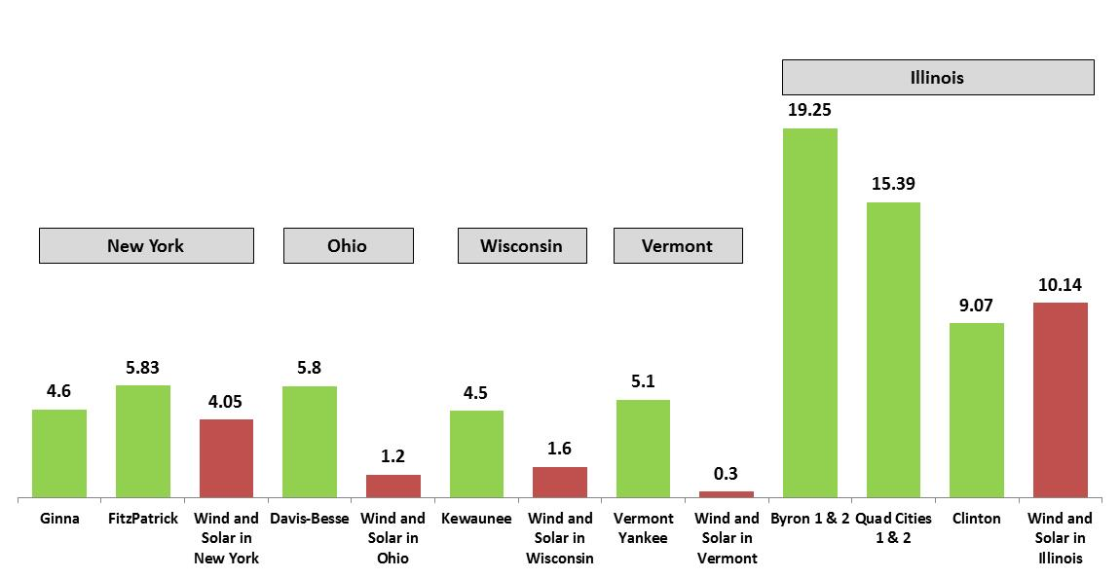
The Challenge of Replacing Nuclear with Renewables
(billions of kilowatt-hours)
In reality, a nuclear plant would never be replaced with renewables because solar and wind are intermittent and non-dispatchable. Nuclear plants are dispatchable and operate 24-by-7. Prematurely retired nuclear is replaced largely by emitting generation.
Following nuclear retirements, electricity demand is met by increased utilization of other resources such as natural gas-fired plants. While gas-fired resources are lower emitting than coal plants, they nonetheless emit carbon and other pollutants.
Source: Energy Information Administration. 2014 data except for Kewaunee (Wisconsin), which is 2012 generation, its last full year of operation
4

Slide 6
New York Clean Energy Standard
On August 1, 2016, the New York Public Service Commission issued its Order Adopting a Clean Energy Standard (CES).
The CES Order was an outgrowth of a December 2, 2015, directive from New York Governor Cuomo to develop a Clean Energy Standard (CES) to achieve emissions reductions and renewable resource development goals.
General Elements of the Clean Energy Standard adopted in the CES Order
Adopts the goal that 50% of NY electricity needs be satisfied through renewables by 2030.
Adopts a Renewable Energy Standard requiring
Load serving entities to invest in new renewables (Tier 1) and
Distribution utilities to continue investing in existing renewables (Tier 2).
Adopts a Zero Emissions Credit program (Tier 3) requiring LSEs to invest in preserving existing at-risk nuclear zero-emissions attributes.
The carbon-free benefits of nuclear zero-emissions attributes contribute to NY’s comprehensive goal to reduce greenhouse gas emissions by 40% by 2030, but do not count towards the goal of 50% renewables by 2030.

Slide 7
New York Zero Emission Credit Program
Purpose of ZEC Program
“The intent of the ZEC program is to preserve the zero-emissions attribute benefits of the [nuclear] facilities to prevent backsliding in the State's carbon reduction performance that likely could not be avoided in any other way.”
General Structure
Builds on well-established REC programs to “properly value[]” the “emission-free attributes from eligible operating nuclear generating plants.”
A ZEC reflects “the zero-emissions attributes of one megawatt-hour of electricity production by an eligible Zero Carbon Electric Generating Facility which credit is purchased by NYSERDA or a Load Serving Entity to reduce carbon consumption by retail electric consumers in New York State.”
ZECs will be sold by eligible generators to NYSERDA, and all LSEs will be required to purchase ZECs from NYSERDA annually in proportion to their load ratio share.
Contract term: 12 years, made up of six two-year tranches.
Program designed to accommodate future federal zero emissions programs.
Eligibility Requirements: Finding of “Public Necessity” to preserve zero-emissions attributes
Verifiable historic contribution of facility to NY clean energy resource mix.
Wholesale revenues inadequate to preserve the zero-emission attributes.
Costs and benefits relevant to other alternatives.
Ratepayer impact & public interest.
Ginna, Nine Mile Point, and FitzPatrick found eligible for first tranche; other nuclear potentially eligible for future tranches.
6

Slide 8
New York ZEC Pricing Mechanism
Overview
Value based on social cost of carbon by USIWG, but can be adjusted downward after first two years to account for forecasted increases in energy and capacity prices, thereby protecting consumers if electricity prices are forecasted to rise.
ZEC Formula
SCC – (Baseline RGGI Effect) – (Energy + Capacity Forecast in Excess of $39/MWh)
Elements of Formula
SCC is based on values developed by USIWG in 2015 and escalates over six, two-year tranches.
Baseline RGGI Effect is intended to avoid double counting RGGI and is set for all tranches at $10.41/short ton.
The Forecast Energy & Capacity Price Change Adjustment can reduce the ZEC price below the SCC if energy and capacity prices are forecasted to rise above $39/MWh. Energy forecasts are based on ICE futures for NYISO Zone A. Capacity forecasts are based on NYMEX futures for rest-of-state.
ZEC Price -- $17.48/MWh for first two-year tranche.
ZEC Value – ZEC necessarily cost justified based on the carbon benefit alone.
7

Slide 9
Illustration of ZEC Pricing
(Illustrative) | Upstate ZEC Price based on SCC ($/MWh) | Zone A Reference Price ($/MWh) | Forecast Zone A Energy plus ROS Capacity Price ($/MWh) | Zone A Reference Price minus Forecast ($/MWh) | Resulting Upstate ZEC price ($/MWh)
Example 1: Market prices increase per price forecast used in DPS staff Cost Study
4/17 – 3/19 | $17.48 | NA | NA | NA | $17.48
3/19 – 3/21 | $19.59 | $39 | $56 | ($17) | $2.59
4/21 – 3/23 | $21.38 | $39 | $64 | ($25) | $0.00
4/23 – 3/25 | $23.56* | $39** | $69 | ($30) | $0.00
4/25 – 3/27 | $25.00* | $39** | $75 | ($36) | $0.00
4/27 – 3/29 | $26.26* | $39** | $78 | ($39) | $0.00
Example 2: Market prices decline (same price as if market prices remained flat)
4/17 – 3/19 | $17.48 | NA | NA | NA | $17.48
3/19 – 3/21 | $19.59 | $39 | $38 | $0 | $19.59
4/21 – 3/23 | $21.38 | $39 | $37 | $0 | $21.38
4/23 – 3/25 | $23.56* | $39** | $36 | $0 | $23.56
4/25 – 3/27 | $25.00* | $39** | $35 | $0 | $25.00
4/27 – 3/29 | $26.26* | $39** | $34 | $0 | $26.26
* Assumes that the Social Cost of Carbon $/ton to $/MWh conversion factor is reduced starting in tranche 4 as per page 136-138 of the CES Order based on assumed renewables of 51.23 TWh in 2022, 56.06 TWh in 2024, and 60.87 TWh in 2026. If actual achieved renewable generation is different than these assumed amounts, the ZEC price will be different than shown here. ** The Zone A Reference Price for tranches 4 through 6 assumes that the energy basis adjustment described on pages 140-141 of the CES Order does not result in a adjustment to the Reference Price.
8

Slide 10
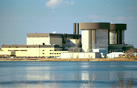
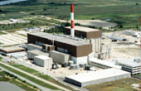
Nuclear Generation in Illinois
Exelon operates 11 reactors at six nuclear plants that …
Employ 5,300 full-time workers from 43 Illinois counties with an annual payroll of $550 million ¹
Employ another 1,300 temporary workers four to five times a year with a total annual payroll greater than $200 million
Spend $441.7 million annually on direct purchases from 3,217 local and state businesses
Create more than 13,000 ancillary jobs in other Illinois business sectors through payroll spending, purchases and contracting activity²
Paid more than $129 million in local property taxes in 2013 to fund school districts and other community spending priorities
Paid more than $26 million in Illinois payroll taxes and $22 million in direct payments to the Illinois Emergency Management Agency in 2013
Exelon’s nuclear plants inject nearly $1 billion directly into the Illinois economy each year and account for more than 18,000 direct and indirect jobs in the state.
1 Full Time Equivalent positions including employees and contractors
2 2007 Impact Analysis for Planning (IMPLAN) for Exelon Nuclear
9

Slide 11
Early Retirement of Clinton and Quad Cities Process
We have begun the process of shutting down Clinton Power Station on June 1, 2017 and Quad Cities Generating Station on June 1, 2018
Quad Cities
May 5, 2016 - announced plan to prematurely retire Quad Cities if adequate legislation was not passed and the plant fails to clear PJM capacity auction.
Clinton
May 5, 2016 - announced plan to prematurely retire Clinton if adequate legislation was not passed.
May 24, 2016 – PJM auction results announced and revealed that Quad Cities did not clear.
May 31, 2016 - Illinois General Assembly adjourned without addressing the various energy proposals.
June 2, 2016 - announced plans to close the Quad Cities on June 1, 2018.
July 7, 2016 - notified PJM of its plans to retire the Quad Cities plant.
May 31, 2016 - Illinois General Assembly adjourned without addressing the various energy proposals.
June 2, 2016 - announced plans to close the Clinton stations on June 1, 2017.
June 20, 2016 - notified the Nuclear Regulatory Commission (NRC) of plan to retire the Clinton.
June 20, 2016 - notified the Nuclear Regulatory Commission (NRC) of plan to retire the Quad Cities plant.
10

Slide 12
Existing Nuclear is the Most Cost Effective Zero Carbon Choice
Estimated Carbon Price Needed to Preserve Existing Nuclear, Coal to Gas Redispatch and Renewable Entry at Near-Term Technology Costs
$250
Market
Federal Tax Subsidies
$200
State Subsidies
Unsubsidized Shortfall vs. Market
$150
Social Cost of Carbon
$100
$/MWh Above Market
$50
$0
-$50
Existing Nuclear in Illinois
Coal to Gas Redispatch
New Build Illinois Wind
New Build Illinois Utility-Scale Solar
Illinois C&I Distributed Solar
Illinois Residential Distributed Solar
Carbon Price Needed (1) | $16 | <$20 | $54 | $58 | $121 | $286
(1) $/MWh above-market converted to carbon price needed using PJM marginal emission rate of 1,590 lbs/MWh
11

Slide 13
A carbon price drives multiple types of carbon reductions in a fully market-based fashion
Illustrative
…Which drives multiple carbon-reducing processes, via the same market-based price signal
+ Cost of carbon emissions
Variable Fuel cost
Before Carbon
After Carbon
Subsidies/ Nothing
Capacity
Capex
+ Carbon in Energy Price
Capacity
Energy
O&M
Energy
Renewable New Entry Before Carbon
Renewable New Entry After Carbon
Risk
Capacity
+ Carbon in Energy Price
Capacity
O&M
Energy
Fuel
Energy
Nuclear Economics Before Carbon
Nuclear Economics After Carbon
Plus Energy Efficiency and other Demand-Side
12

Slide 14
The Nation Cannot Meet Carbon Goals Without Nuclear
Nuclear Retirements Could Negate A Third of the CO₂ Reductions to Date
100%
67%
50%
17%
33%
Source: EPA; Exelon estimates
Nuclear units assumed to operate at 92% capacity factor, and displace CO₂ at a rate of 0.67 metric tons per MWh of lost output.
EPA estimates its Final Rule could reduce CO₂ emissions nearly 400 million metric tons beyond 2013 levels, but back-sliding with nuclear retirements could erase 1/3 of those reductions .

